Slide 1
Nerve ImpulseTransmission
http://outreach.mcb.harvard.edu/animations/actionpotential_short.swf
https://www.youtube.com/watch?v=9euDb4TN3b0

Slide 2
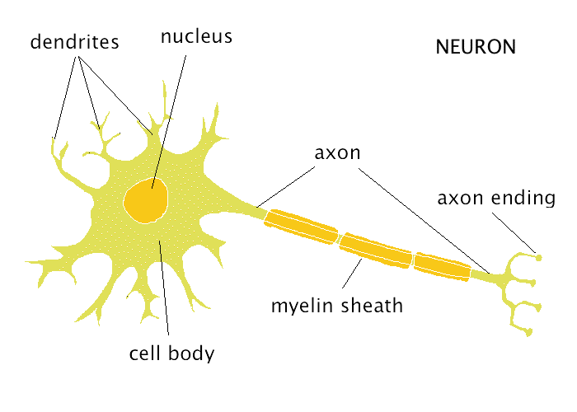
The Neuron (p.395)
a nerve cell -> the structural and functional unit of the nervous system.
carries info from one location in the body to another
capable of surviving over ____ yrs., since most do not undergo cell division after adolescence.
100

Slide 3
The Path: (p. 402 - 403)
electrochemical
The message sent along a neuron is ______________ (known as a wave of depolarization).
It is picked up by _________ and moves to the cell body, where the nucleus interprets the message.
It has to be of sufficient intensity or strength (called the _________stimulus)to be sent along the neuron.
If so, the axon will trigger an impulse down the length of the axon.
dendrites
threshold

Slide 4
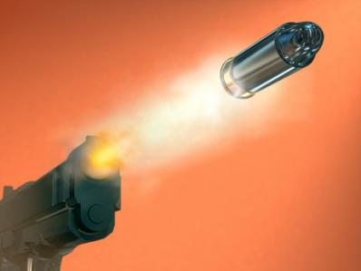
The strength of the response is uniform (the same) along the entire length of the axon and it is independent of the stimulus strength (ie. like the _______ on a gun, once it is pulled , the bullet is on its way; pulling harder on the trigger has no effect on the speed of the bullet.)
Either the impulse is sent or it is not -> the ________________.
trigger
All-or-none principle

Slide 5
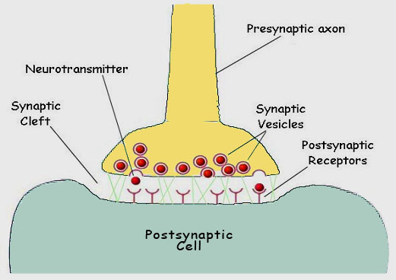
If sent, the impulse continues to the axon _________, and out to the synaptic ____ (or bulbs).
The space between the synaptic knobs of one neuron and the next structure (other neuron, muscle fiber or gland) is called a ______. (P.405)
terminals
knobs
synapse

Slide 6
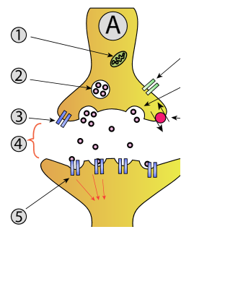
At the synapse, vesicles secrete a _____________across the synapse, causing the cell membrane of the neighbouring structure to become permeable to the impulse, and so the impulse continues... (to contract a muscle, cause a gland to secrete a _______, or pass the message on to another ______).
neurotransmitter
hormone
neuron

Slide 7
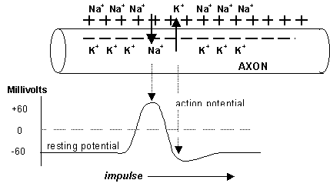
Impulse Transmission: (p. 402 - 404)
The wave of depolarization, sent by the axon, is primarily the movement of two positive ions, ____ and ____from one side of the axon’s cell membrane to the other.
Na+
K+

Slide 8
Phases include...
A. Resting state (polarized)
there is an uneven distribution of + charged ions (cations) outside the membrane and charged ions (anions) inside the membrane; called the _______potential. The difference in charge usually about ____mV.
resting
-70

Slide 9
Resting state cont’d…
Outside axon: -> high Na+ Inside axon:-> low Na+
-> low K + -> high K+
-> some Cl- -> largely negative (proteins, amino acids, phosphates, sulphates)
The membrane has special channels (_____) for movement of the sodium, potassium and chloride ions to go in and out but not the others-> ‘trapped’ within the axon.
gates

Slide 10
The Na+ / K+ pump, found inside the cell membrane, aids the polarization process, pumping __ Na+ out and __ K+ into the axon, increasing the difference in charge.
Unlike other cells, nerve cells have only an ______ metabolism, so they need a constant supply of ______ and use just glucose to metabolize.
The mitochondria in the neuron use oxygen and glucose to produce ___ to fuel the active transport pumps.
3
2
aerobic
oxygen
ATP

Slide 11
B. Depolarization:
K+ gates close
Na+ gates open, moving Na+ _____ the axon, neutralizing negative charge.
the change in the charge is called the ______ _________
the depolarization of one part causes the gates of _____________Na+ channels to open and this continues along the axon. (Action potentials can occur in the ________ and ____ ____ as well.)
into
action
potential
neighbouring
dendrites
cell
body

Slide 12
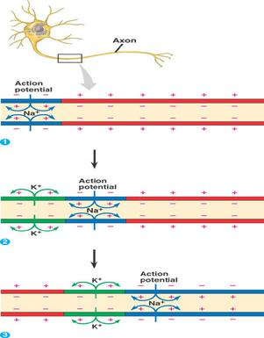
Depolarization cont’d…
the axon changes permeability, allowing the impulse to move _____ the axon.
impulse continues to move along the axon in this wave-like fashion until it reaches the axon ________.
along
terminals

Slide 13
C. Repolarization:
meanwhile, the first section reverses its polarity, to resume the resting state.
Na+ ions are pumped __________,
K+ gates are ___________, and
Na+ gates are _______.
there is a period of time, following the firing of a neuron, when it cannot be re-fired
this is called the __________ ________(or undershoot), and is approx. ______s.
The speed with which the whole process occurs allows an axon to send many impulses along its length every ______.
back out
reopened
closed
refractory
period
0.001
second
http://www.youtube.com/watch?v=P-imDC1txWw
– sodium-potassium pump

Slide 14
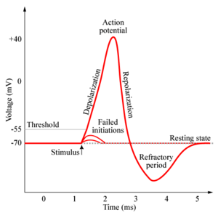

Slide 15
The Synapse: (see Figure 12.16, page 405)
a tiny gap between neurons (say A and B)
‘A’ is the ___________neuron (brings impulse to synapse)
‘B’ is the __________ neuron (receives stimulus from across the synapse)
wave of depolarization, in ‘A’ reaches the terminal branches,
(calcium gates cause) the creation of synaptic vesicles that contain __________________,
vesicles migrate to the end of the synaptic _____,
presynaptic
postsynaptic
neurotransmitters
bulbs
http://www.youtube.com/watch?v=ZuclwAOJFh8

Slide 16
Synapse cont’d…
neurotransmitter diffuses into and across synapse to ‘B’
neurotransmitter attaches to receptor sites of neighbouring ‘B’ dendrites and causes either an __________ or _________ response.
if the dendrites are excited, _______ gates are opened and a wave of depolarization is triggered in the ‘B’ neuron.
an inhibitory response usually involves opening _______ channels, increasing the negative ions in this neuron, thus raising the threshold stimulus, making it less likely to ‘fire’.
excitatory
inhibitory
sodium
chloride

Slide 17
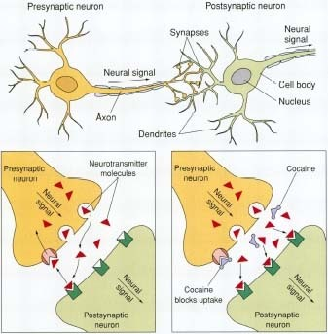
https://www.youtube.com/watch?v=HXx9qlJetSU

Slide 18
Students are to read pages 405-406: - acetylcholine, noradrenaline, glutamate, GABA, dopamine, serotonin

