Slide 1
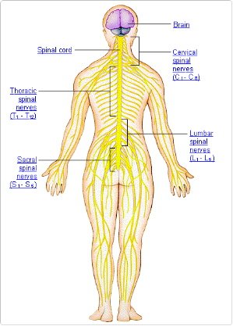
Disorders of the Nervous System (NS)

Slide 2
Multiple Sclerosis
Affects nerve cells of brain and spinal cord
It is believed to be an autoimmune disorder, whereby the Myelin sheath is attacked by the immune system (Inflammation/damage)
Disrupts nerve impulses
Symptoms include;
Slurred speech
Double vision or blurred vision
Loss of coordination; muscle weakness
Tingling, numbness
Attacks may occur in episodes with alternating symptoms (worse-improve-worse)
No Cure but some meds. Suppress the immune response or treat seizures
http://www.youtube.com/watch?v=qgySDmRRzxY

Slide 3
Alzheimer’s Disease
Form of Dementia – impairs intellectual functions
Deterioration of brain – causes memory loss, confusion and impaired judgement
Deposits of amyloid (protein) within the brain – distorts communication between brain cells (hippocampus)
Distortion results in decrease in acetylcholine
Symptoms: problems retaining info, forgetting ‘new’ memories. Eventually forget ‘old’ memories, significant others or ‘simple’ tasks. Personality changes may occur (irritable, anxious, delusional, aggressive)
Cholinesterase inhibitors boosts acetylcholine levels
Mental function deteriorated 3-20 years before death
http://www.youtube.com/watch?v=9Wv9jrk-gXc

Slide 4
Parkinson’s Disease
Movement disorder caused by death of neurons that produce dopamine
Dopamine carries messages between areas of the brain controlling body movement
Begin as slight tremors or stiffness on one side of the body
Progresses to both sides, limbs become rigid, movements slow, and gait is abnormal
First symptoms appear after 70-80% of dopamine-producing cells have died
No cure; treatments include boosting dopamine levels or mimicking the effects of dopamine (long term use can cause mental impairments), - surgical treatments involve creating lesions or implanting electrodes in affected areas.
http://www.youtube.com/watch?v=v8JCzz0tCds

Slide 5
Meningitis
Viral/Bacterial infection of meninges (three
membranes that cover and protect the spinal cord)
Viral more common (especially in children) clears in 7-10 days
Bacterial can be fatal if not treated immediately & can leave more serious , long term effects (i.e., hearing loss)
Symptoms: Headache, fever, stiff neck, light sensitivity, vomiting, drowsiness
Diagnosed with spinal tap/lumbar puncture (tests spinal fluid for bacterial presence or immune response)
Prevention by hand washing or vaccination (none for viral)
http://www.youtube.com/watch?v=eVswuWrxif8

Slide 6
Huntington’s Disease
Fatal autosomal dominant disorder
where nerve cells degenerate
Decline in mental and emotional capabilities, and control over major muscle movements
50% chance of inheriting disease if a parent has it
No cure/no way to slow progression
Symptoms: Memory loss, Dementia, Twitching, Clumsiness, Chorea (Greek for dance – jerk), Personality changes
Symptoms appear in mid-life and progress over ~15 years till death.
http://www.youtube.com/watch?v=ta6AOyc21Gg
http://www.youtube.com/watch?v=HBLrY_nXU_U&feature=related

